Slide 1
use cases of clustering

Slide 2
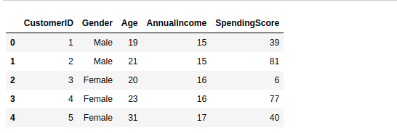
Use Case 1. Customer segmentation
1. Collection of Data
Some of the features in the data are customer ID, gender, age, income(in K$), and spending score of customers based on spending behavior and nature.
This example aims to divide the customers into several groups and decide how to group customers in clusters to increase customer value and company revenue. This use case is commonly known as customer segmentation.

Slide 4
2. Import libraries
import numpy as np
import pandas as pd
import matplotlib.pyplot as plot
import seaborn as sns
import plotly.express as pxp
import plotly.graph_objs as gph
from sklearn import metrics
from sklearn.metrics import silhouette_score
from sklearn.cluster import KMeans

Slide 5
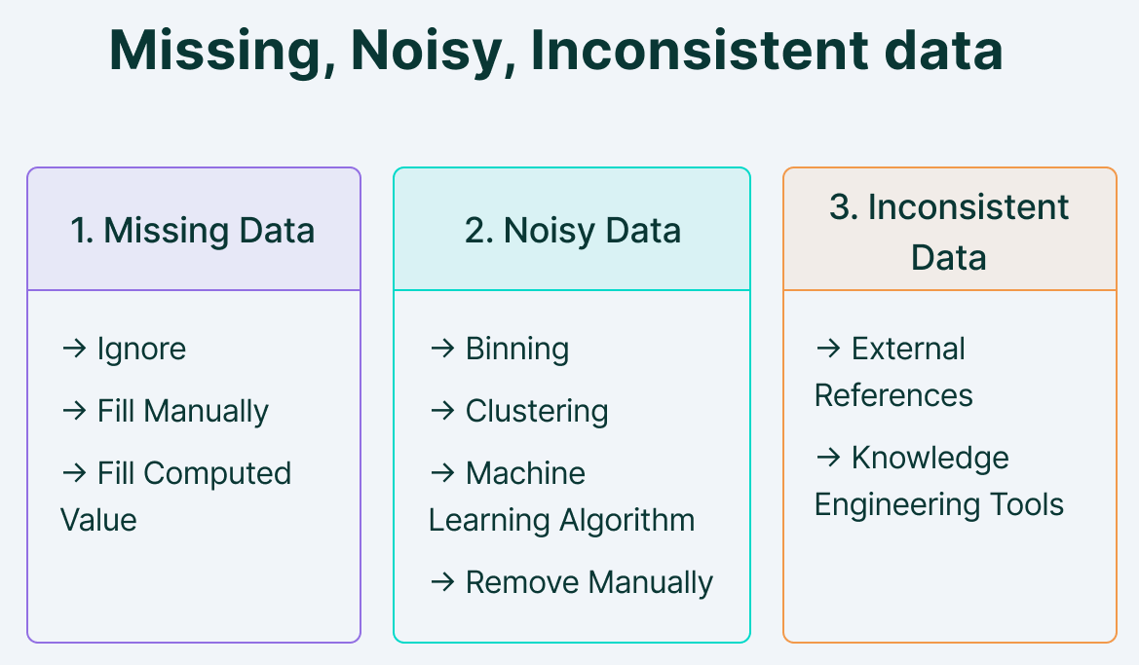
3. Pre-processing of dataset

Slide 6
Handling Missing values:
Duplicate or missing values may give an incorrect view of the overall statistics of data.
Ignore those tuples
Fill in the missing values
Noisy Data and Removing outliers:
Outliers and inconsistent data points often tend to disturb the model’s overall learning, leading to false predictions.
Binning

Slide 7
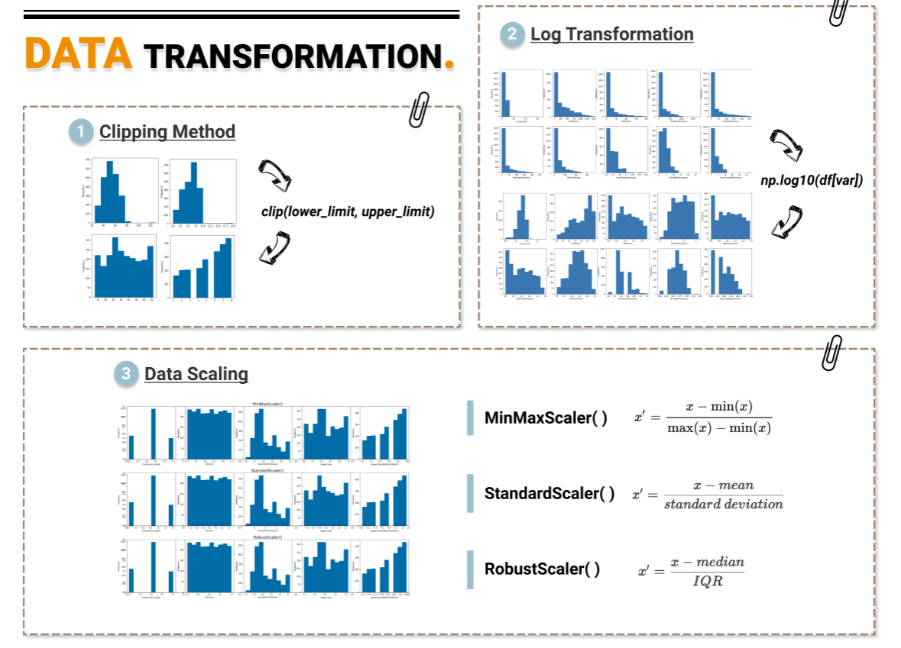
Data Transformation

Slide 8
Step 4: Use K-means clustering
it finds all of the different “clusters” and groups them together while keeping them as small as possible. That means that you end up with the most possible customer segments to interpret.
an “elbow” at k=4 tells us that four customer groups are ideal for this dataset.

Slide 9
Step 5: Visualization and interpretation
visualize the findings and interpret it to grow your business.
There are four customer groups with various product orders, spending, and return rate amounts. This allowed the company to clearly see the most favourable customer profile to target.

Slide 10
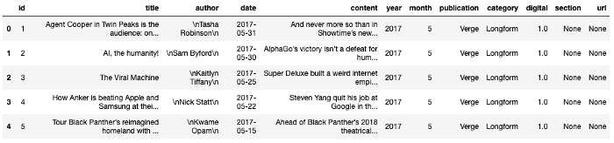
Use Case 2: News Article Clustering
Step 1: Dataset
The data I am using is roughly 97k news articles that come from the years 2013–2017 and range from roughly 2k-15k characters in length. I store the dataset in a pandas dataframe for analysis, preview shown below.

Slide 11
Data Preprocessing
Eliminate non english articles
Tokenize, lemmatize, and stem words within each article
Concatenate words of each record into a string and convert the entire pandas series into a list of strings
Perform Count Vectorization and remove stop words

Slide 12
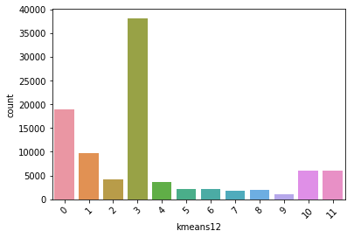
Apply K-Means Clustering algorithm
K-Means Clustering algorithm which groups data points into a set amount of clusters based on the point’s location relative to the ‘centroids’.

Slide 13
Now let’s look at the top words in each cluster:
Cluster 0: state, new, year, president, people, nation, one, unit, country, govern
Cluster 1: Trump, president, Donald, would, white, house, campaign, American, Washington, administration, nation
Cluster 2: Trump, republican, party, Donald, democrat, presidential, senate, candidate, GOP, voter, nominee
Cluster 3: one, year, new, first, world, game, live, week, people, make, get, say, work, show
Cluster 4: Clinton, Hillary, Trump, democrat, campaign, Sanders, presidential, election, emails, Bernie, support

Slide 14
Use case 3: Classification of social network users
Each network consists of:
Nodes: The individuals whose network we are building.
Edges: The connection between the nodes. It represents a relationship between the nodes of the network.
The first network that we create is a group of people who work together. This is called a symmetric network because the relationship “working together” is a symmetric relationship: If A is related to B, B is also related to A.

Slide 15
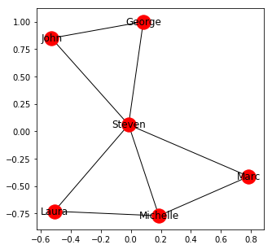
Now we visualize the network.

Slide 16
Apply K nearest neighbor (kNN) or Decision Trees algorithm.
There are 4 classes that are used on Facebook, including photo, status, video and link.
Features and explanation
1 Total liked pages
2 Category
3 The day the submission was published (1-7)
4 Number of people who saw
5 Number of clicks and clicks
6 Number of people who click anywhere in the post
7 Number of likes
8 Number of shares sent
9 Sum of likes, comments and shares
10 Class (Status, Photo, Link, Video)

Slide 17
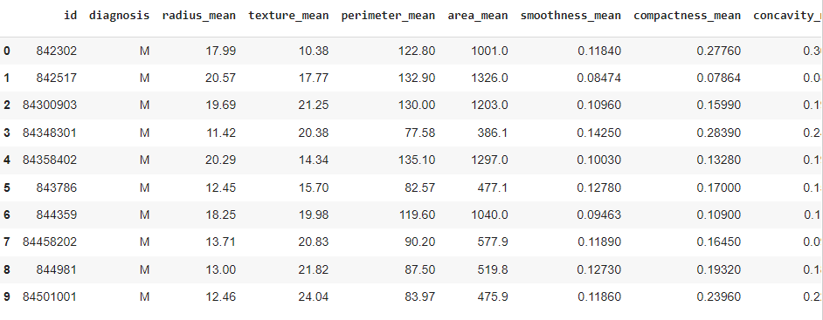
Use case 4: Cancer Classification
1. Loading the data

Slide 18
2. Normalize Data- scale 0 to 1
3. Training and Testing the data-We perform train, test split on our model
4. Classification-
Now, we use the KNN algorithm
KNeighborsClassifier(n_neighbors = k).

Slide 19
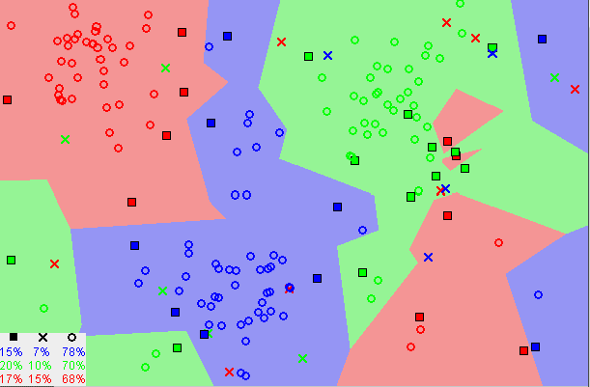
KNN captures the idea of similarity (sometimes called distance, proximity, or closeness)

